Slide 1
Comparative Analysis of Optimizers for Bird Classification using MobileNetV2
Under the guidance of
Dr Kshira Sagar Sahoo
SANDEEP REDDY PANYALA – AP24122060005
SRI HARSHA VARDHAN GOGISETTY – AP24122060007
MADDI ESWAR - AP24122060014

Slide 2
Problem Statement
With the increasing volume of bird imagery in ecological studies and wildlife monitoring, accurately classifying bird species from images has become a crucial yet challenging task. Traditional models often fall short in terms of accuracy or computational efficiency.
This project addresses the challenge of efficiently training a deep learning model to classify various bird species while systematically evaluating the impact of different optimization algorithms on model performance, convergence speed, and training time.

Slide 3
Objectives of the Project
To classify bird species using deep learning with MobileNetV2 variants.
To compare the performance of multiple optimizers – SGD, SGD with Momentum, Adam, and Nadam – on the same architecture and dataset.
To evaluate optimizers based on:
Training time (total and per epoch),
Convergence rate (how quickly the loss minimizes),
Final classification accuracy on validation data.
To identify the most efficient optimizer for training MobileNetV2 on bird image data with minimal resource consumption and maximum accuracy.

Slide 4
Literature Review
Howard, A.G., Zhu, M., Chen, B., Kalenichenko, D., Wang, W., Weyand, T., Andreetto, M. and Adam, H., 2017. Mobilenets: Efficient convolutional neural networks for mobile vision applications. arXiv preprint arXiv:1704.04861
MobileNetV1: Introduced depthwise separable convolutions for lightweight models.
MobileNetV2: Enhanced feature reuse and efficiency with inverted residuals and linear bottlenecks.
MobileNetV3: Leveraged NAS and attention mechanisms for improved performance.
MobileNetV4: Incorporated advanced modules and attention techniques for state-of-the-art mobile vision models.

Slide 5
Literature Review
Manna, A., Upasani, N., Jadhav, S., Mane, R., Chaudhari, R. and Chatre, V., 2023. Bird image classification using convolutional neural network transfer learning architectures. International Journal of Advanced Computer Science and Applications, 14(3)
All models were trained under the same conditions (input size, epochs, learning rate, frozen layers, SoftMax activation), ensuring a fair and unbiased comparison. Training was performed on Google Colab using 15 epochs and a learning rate of 0.01.
While ResNet152V2 achieved the highest accuracy, it had the highest loss, making DenseNet201 the most reliable and stable model for real-life applications. MobileNetV2, despite slightly lower accuracy, was faster and more efficient, making it suitable for on-device classification.

Slide 6
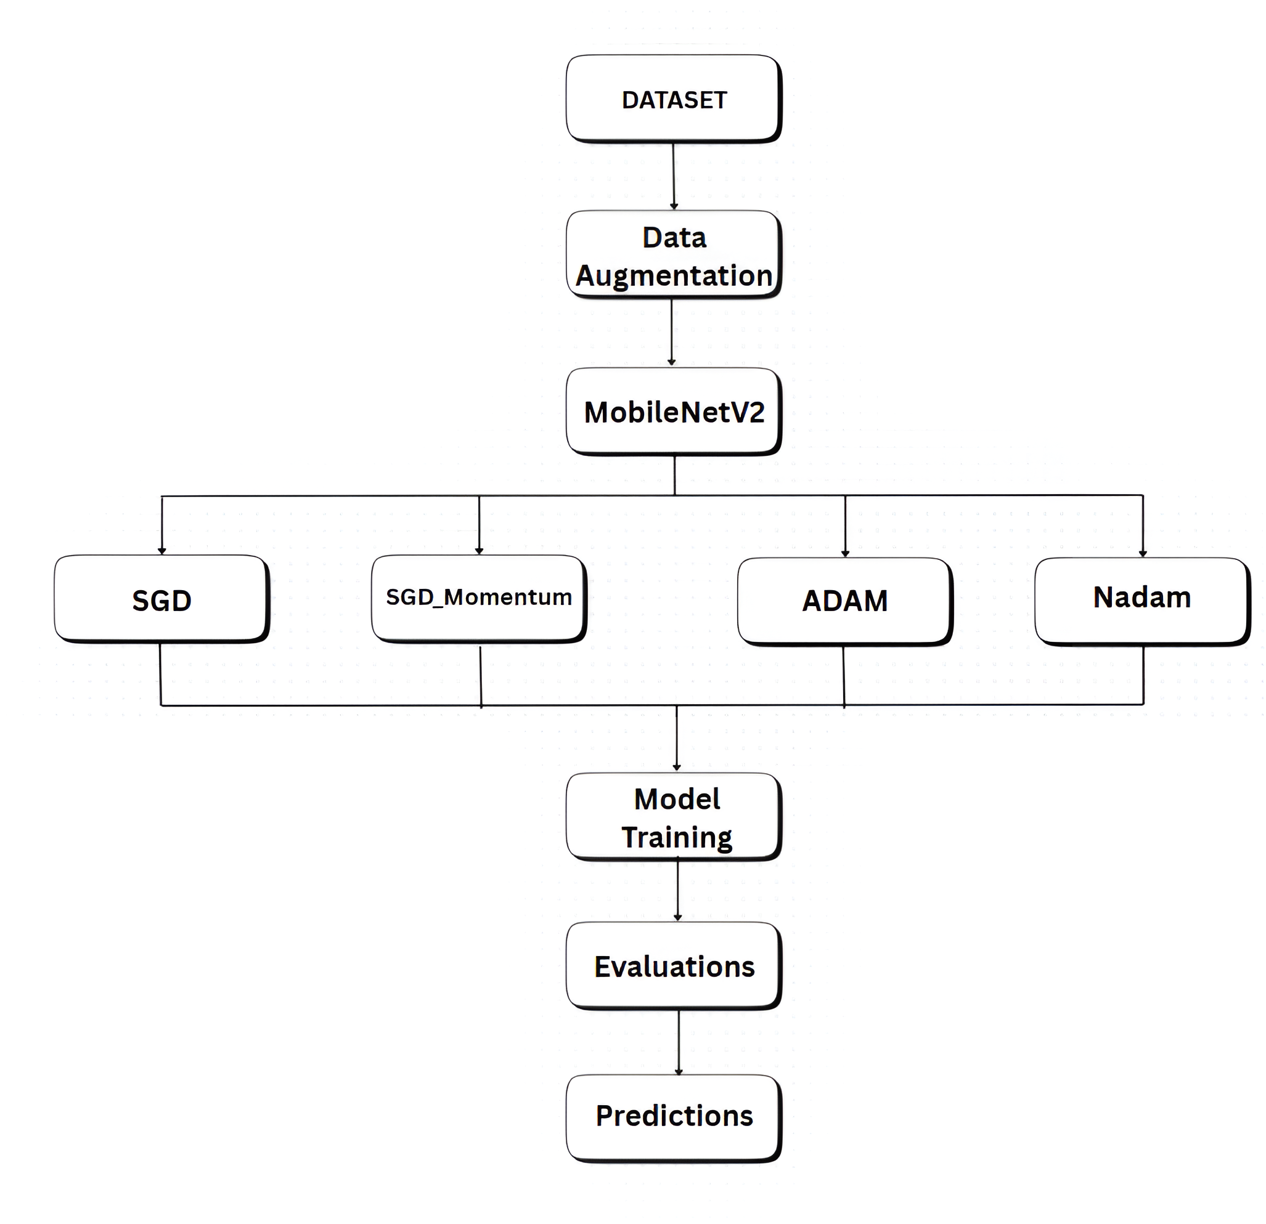
Work Flow

Slide 7
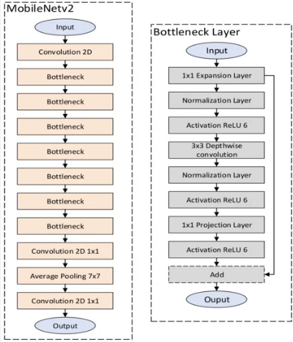
MobileNet V2 Architecture

Slide 8
Model Components
Learning rate –Utilized the default running rate of the Optimizers
Optimizers used
SGD (learning rate =0.01)
SGD_momentum (learning rate = 0.01, momentum=0.9)
Adam (learning rate = 0.001)
Nadam (learning rate = 0.002)
Batch size - 32
Image size - (224,224)
Epochs – 10
Loss Function – categorical_crossentropy

Slide 9
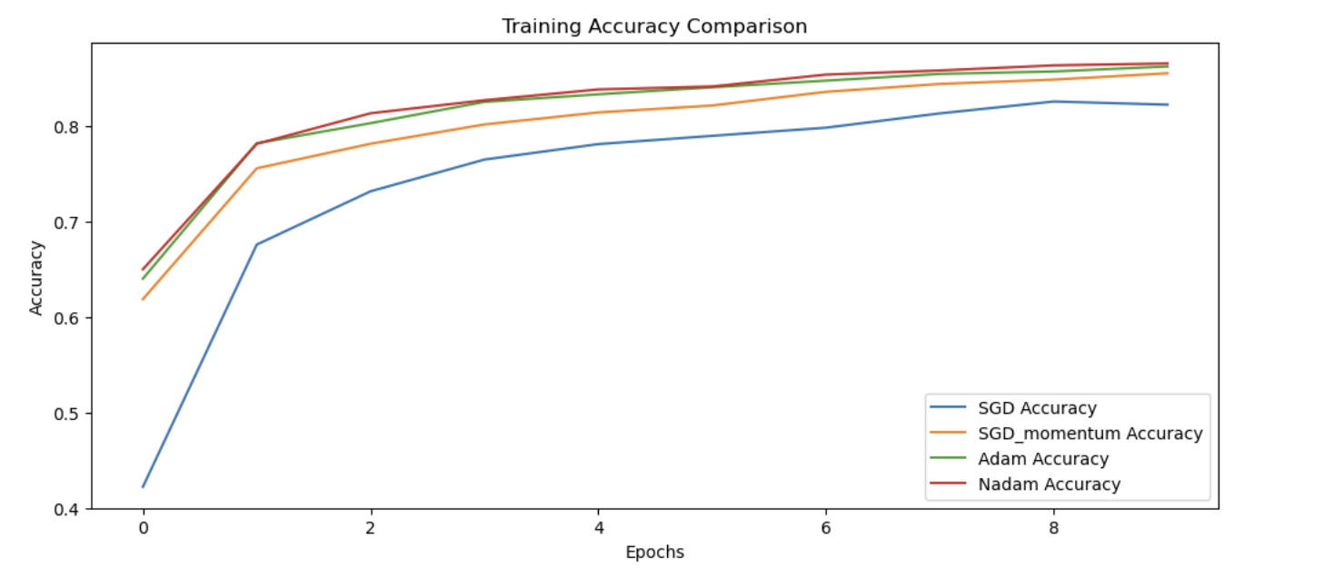
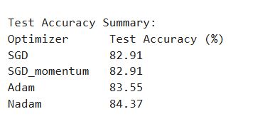
Performance metrics
During the training phase at the last epoch the model attained results with respect to each optimizer are
SGD – 82.55%
SGD_momentum – 85.52%
ADAM – 86.56%
Nadam – 86.41%
Training accuracy comparisons considering all optimizers
Testing accuracy results considering randomized input of 235 images

Slide 10
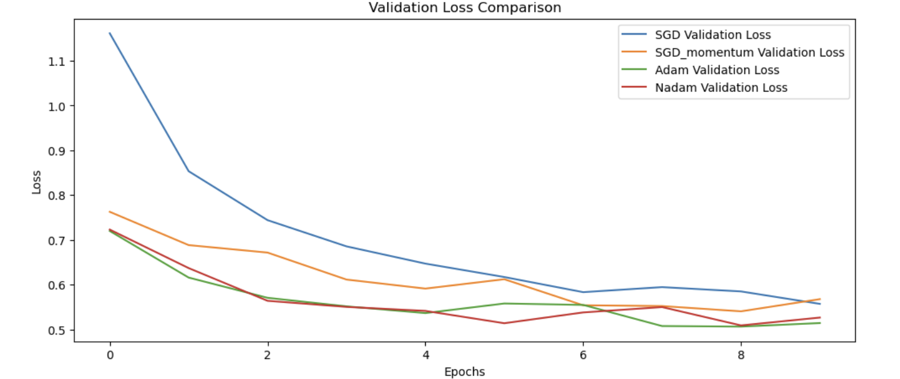
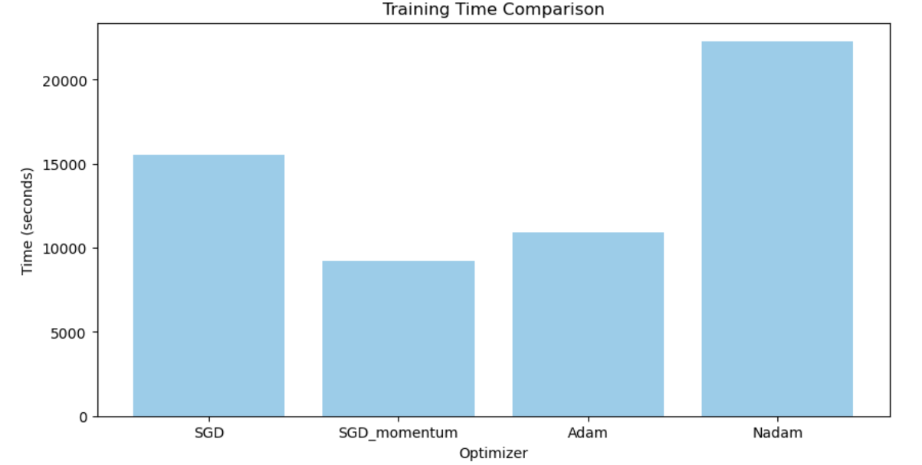
Performance metrics
Validation loss computation considering all optimizers
Training time comparisons considering all optimizers

Slide 11
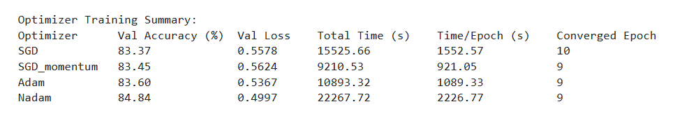
Performance Metrics
Summarized comparisons considering all optimizers

Slide 12
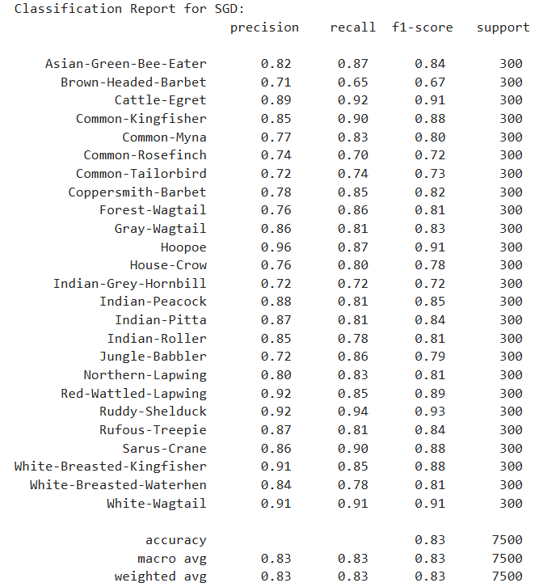
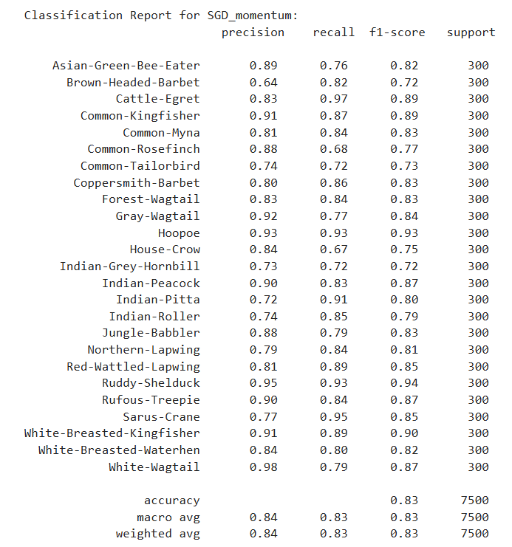
Classification Reports

Slide 13
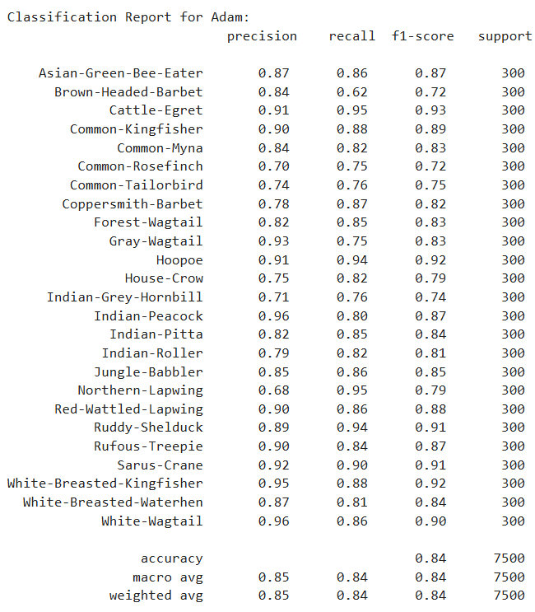

Classification Reports

Slide 14
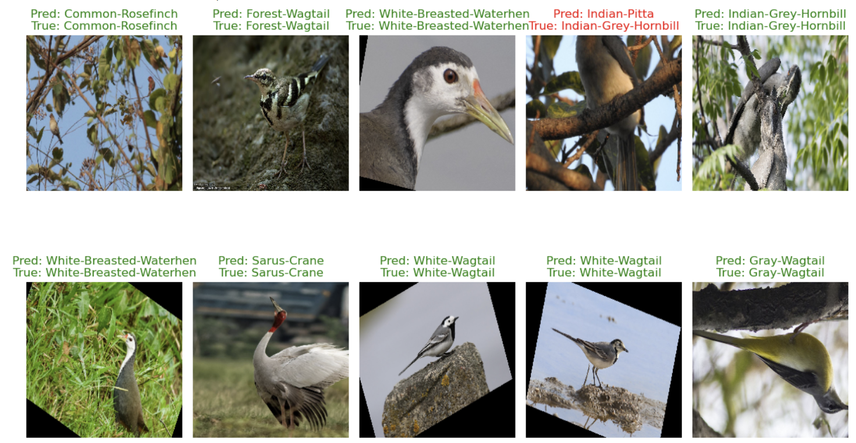
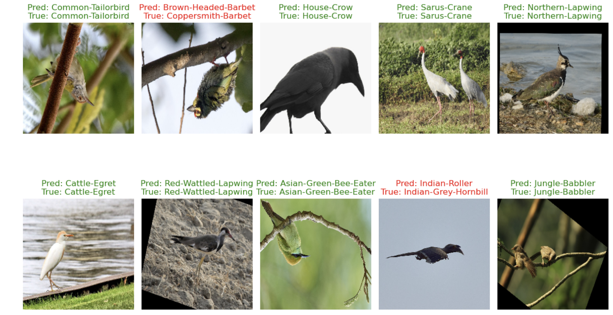
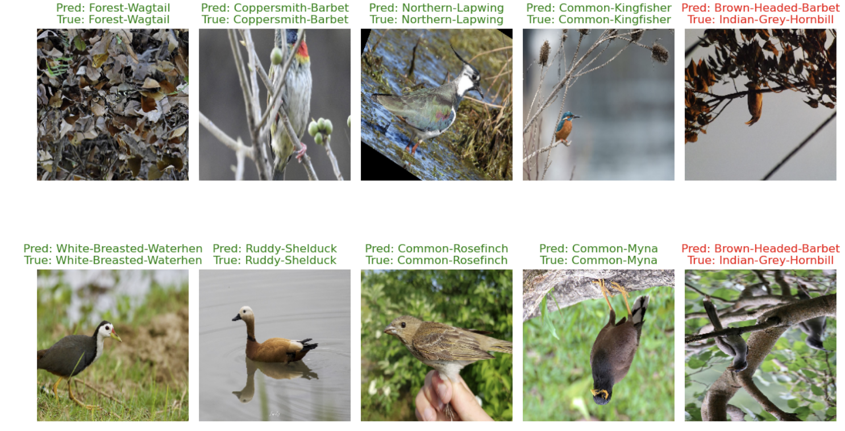
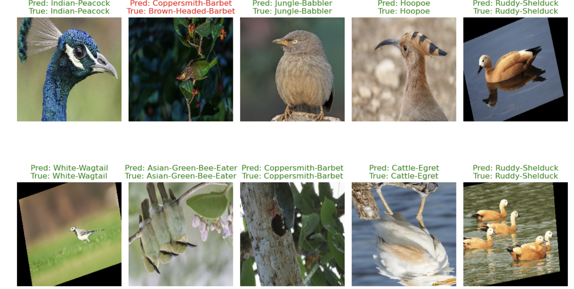
Performance Metrics
NADAM predictions
ADAM predictions
SGD_momentum predictions
SGD predictions

